Slide 1
Respiratory Diagnosis
Assistant Application
Team 8
Minjun Kim (mkim925@gatech.edu)
Nabin Kim (nabin@gatech.edu)
Sandra Kurian (skurian32@gatech.edu)
Seohee Yoon (syoon333@gatech.edu)

Slide 2
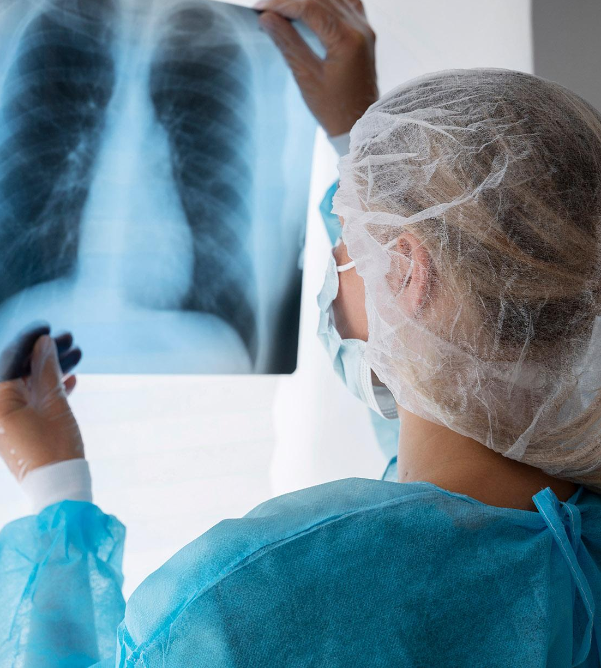

Our GOAL
Automate lung sound classification for healthcare professionals for more effective patient care
Develop a user-friendly app for querying lung sound files
Predict diseases based on the audio file
Instantly access relevant audio samples based on disease name and meta data
Allow user contributions to improve database accuracy
COPD
Notes:
Today, we are going to talk about our project, Respiratory Diagnosis Assistant Application, aiming to enhance respiratory disease diagnosis through automated lung sound classification. Before beginning let’s listen to the example lung sound file.
Our objective is to develop a user-friendly application for querying these confusing lung sound audio files, streamlining the diagnostic process for healthcare professionals.
By leveraging advanced machine learning techniques and optimized database management practices, we aim to provide instant access to relevant audio samples based on disease input and facilitate predictive disease identification from lung sound patterns.
Moreover, the application will serve as a collaborative platform, allowing users to contribute new audio recordings and metadata to enhance the database's accuracy over time.
The target users are medical professionals, including doctors, nurses, physicians, and specialists, who will utilize the platform to streamline their workflow and access patient information efficiently.

Slide 3
Intended User
Medical Professionals
We can expect that the medical professionals would use our application to
Streamline their workflow
Access relevant patient information efficiently
Interpret diagnostic results
Notes:
Our application targets medical professionals—doctors, nurses, physicians, and specialists—enabling them to streamline workflow, access patient data efficiently for reference, and interpret diagnostic results more accurately. This streamlined approach not only saves valuable time but also contributes to improved patient outcomes and healthcare delivery.

Slide 4
Data
Available Dataset
Data used for project
Demographic_info.text
126 patient Information
Patient number, Age, Sex,...
Audio files and text files
Lung sound files for each patient
Corresponding annotation files
Beginning of respiratory cycle, End of respiratory cycle,
Patient_diagnosis.csv
Consist of patient number and disease name that the patient has
Filename_format.txt
File naming convention
Demographic_info.text
To show related patient information when user searches specific disease
Audio files and txt files
To train our machine learning model for classifying a disease name with user input (audio files)
To provide further context for better diagnosis assist
Patient_diagnosis.csv
To connect disease name that each patient has with the patient information and audio file
Notes:
We chose Respiratory Sound Database from Kaggle. It is composed of four directories.
Firstly, Demographic Information: We have demographic data for 126 patients, including patient number, age, and sex.
Audio and Annotation Files: Our database contains lung sound files and corresponding annotation files, detailing respiratory cycle information.
Patient Diagnosis Data: We store patient diagnosis information in a CSV file, linking patient numbers with their diagnosed diseases.
Filename Format Convention: We follow a standardized naming convention for our files, outlined in the 'Filename_format.txt' document.
These are the data that we used for the project. Firstly, the Demographic_info.txt file includes detailed patient information. Additionally, we have a collection of audio, which is used as the daa pool to train the machine learning model and we use associated text files for further contextual information that would be helpful for diagnosis assistance. Lastly, the Patient_diagnosis.csv file serves as the answer key for the machine learning model and is used for audio search.

Slide 5


Database Design
MongoDB (NoSQL)
Amazon S3
Used MongoDB to handle varying and complex data structures such as JSON files and array of embedded documents. Because we mainly retrieve data in bulks and in large volumes, we benefit from MongoDB’s capability to read document-based data quickly.
Used Amazon S3 to store large audio files and annotation text files. S3 is designed to handle large amounts of data in the form of objects.

Slide 6
Database Design
Patients
│
├── patient_id (AutoField, Primary Key)
├── age (IntegerField)
├── sex (CharField, max_length=10)
├── adult_bmi (FloatField, nullable)
├── child_weight (FloatField, nullable)
├── child_height (FloatField, nullable)
├── RespiratortyData (ArrayField)
│ └── Embedded Documents:
│ ├── id (IntegerField, Primary Key)
│ ├── recording_index (CharField, max_length=3)
│ ├── chest_location (CharField, max_length=2)
│ ├── acquisition_model (CharField, max_length=2)
│ ├── recording_equipment (CharField, max_length=20)
│ ├── annotation_file (CharField, max_length=255)
│ ├── respiratory_cycles (JSONField)
│ └── sound_file_path (CharField, max_length=255)
├── average_cycle_duration(FloatField, nullable)
│
└── Diagnosis (Foreign Key Relationship to Diagnosis)
└── Related Documents:
├── patient_id (ForeignKey, references Patients.patient_id)
└── diagnosis_name (CharField, max_length=100)
Our Patients model is the central model, managing data related to all patients.
patient_id is the primary key for this model, and this will later be used to refer Patients from Diagnosis.
RespiratoryData contains detailed data on respiratory analyses, and it is an array of embedded documents.
annotation_file and sound_file_path points to the annotation file (.txt) and sound file (.wav) in Amazon S3.
Diagnosis references to the Patients model and contains the diagnosis information (disease name).
We show two ways of how MongoDB handles relationships between documents, embedded documents and manual referencing.
We also showcase MongoDB’s aggregation pipeline in calculating average_cycle_duration, enabling us to significantly reduce calculation time.

Slide 7

Django
Python web framework
Object-Relational Mapping (ORM)
abstract details of SQL queries
define database models using Python classes
Django handles the translation to SQL queries
admin interface
manage data through a web interface without having to write custom admin panels
scalable
capable to handle high traffic loads
(Instagram/Pinterest use Django)
Notes:
SANDRA - PURPOSE
We decided to use Django to build our application
high level python web framework
main reasons as to why we picked it
ORM ALLOWS US TO define database models using Python classes
DJANGO DOES the translation to SQL queries
admin interface
manage data through a web interface without having to write custom admin panels
scalable

Slide 8
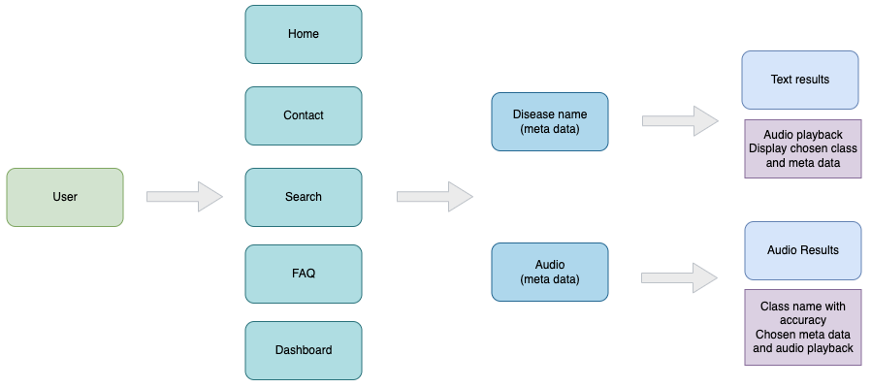
Application Layout
Notes:
SANDRA - APPLICATION LAYOUT
Home Page
give users a high-level understanding of what application is and what they can expect to find
list of conditions + additional info (educational resources)
Search/Results Page
in depth next slide
FAQ/Contact Page
users to find answers to common questions about using the application
instructions on how to use
feedback system for users to provide input or report issues
logged for review and improvement of the application.
Technologies/Languages: HTML, CSS, JavaScript, Python (Django framework)
Libraries: Django (for backend logic), Bootstrap (for frontend styling and layout)
Special Features:
FAQ section: Structuring frequently asked questions and their answers for easy reference.
Contact form: Implementing a form for users to provide feedback or ask questions, with backend logging of submissions.
Feedback logging: Storing user feedback in a database for review and analysis.

Slide 9
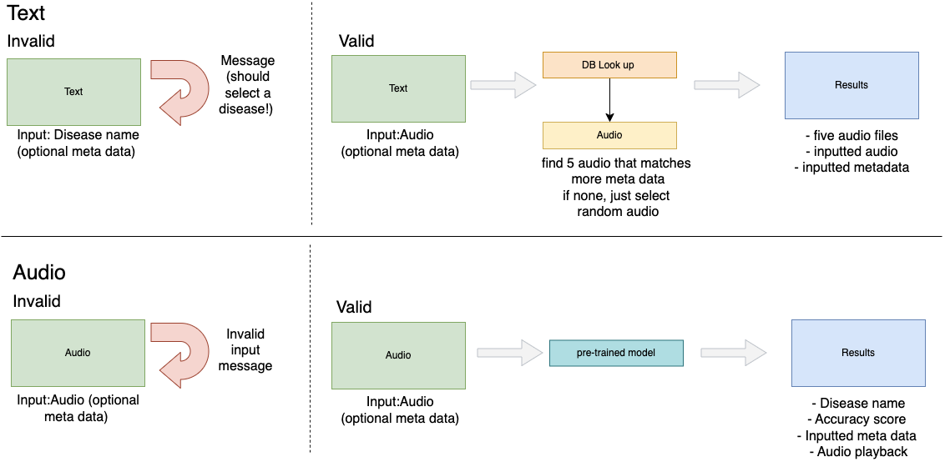
Search/Results Page
Incremental learning
Backend update when score > 0.7 to pretrain the model
Notes:
SANDRA - SEARCH/RESULTS PAGE
SEARCH USE
input search criteria to find relevant lung sound audio files
TEXT INPUT
search condition type + optional demographic info
output top 5 audio files which best match the input
if no additional demographic info → will provide 5 audio files of that diagnosis
AUDIO INPUT
can input audio + optional demographic info
will implement ML and output
condition name + accuracy score
audio playback
IF 70% acc score → incremental learning data point
Using the pre-trained model inside the Django application
model will be fine-tuned using the sklearn’s partial train
SEARCH ERROR
handles cases of invalid audio input (such as)
empty files
files not in .wav or .mp3 format
files outside the acceptable duration range
displays error message instead of directing to the results page
shows the visualizations of the waveform - the color changes when the audio is displayed - not just displayed but if it kinda interacts way so that when the user clicks on the plot, it plays from there
Technologies/Languages: HTML, CSS, JavaScript, Python (Django framework)
Libraries: Django (for backend logic), Bootstrap (for frontend styling and layout)
Special Features:
Checkbox inputs: Using HTML checkboxes for selecting metadata options.
Dropdown menu: Implementing a dropdown menu for selecting disease names instead of text entry.
Input validation: JavaScript validation to ensure valid input (e.g., audio file format, duration range).
Backend validation: Django backend validation to handle invalid input and display appropriate messages.

Slide 10
Machine Learning Function
Audio Classification
Input: valid Audio file (extension, file length, actual lung disease sound)
Process: audio files using Mel Frequency Cepstral Coefficients (MFCC) to extract features
Output: Disease name with similarity score & original audio file and demographics
Trained model using these features instead of raw audio files
Limitations
Lower performance with metadata (chest location, bmi, age, etc) when trained together
Limited number of classes
Currently, our model can classify 6 respiratory diseases for now
Notes:
One of our major goals is to apply machine learning techniques to identify respiratory conditions based on audio recordings. Our approach begins with a valid lung sound file. First we extract audio feature using MFCC which is used to capture the shape of the power spectrum of a sound signal. And then train the model using these features to classify the audio files.
The output of our model is twofold. Firstly, it provides the predicted disease name along with a similarity score. Additionally, it returns the original audio file with associated demographics to provide valuable context for medical professionals.
However, we have two limitations. We have observed lower performance when including metadata such as chest location, BMI, and age into the training process alongside extracted mfcc features. Additionally, our current model has the limited number of respiratory diseases to classify, with six diseases being the current scope.

Slide 11
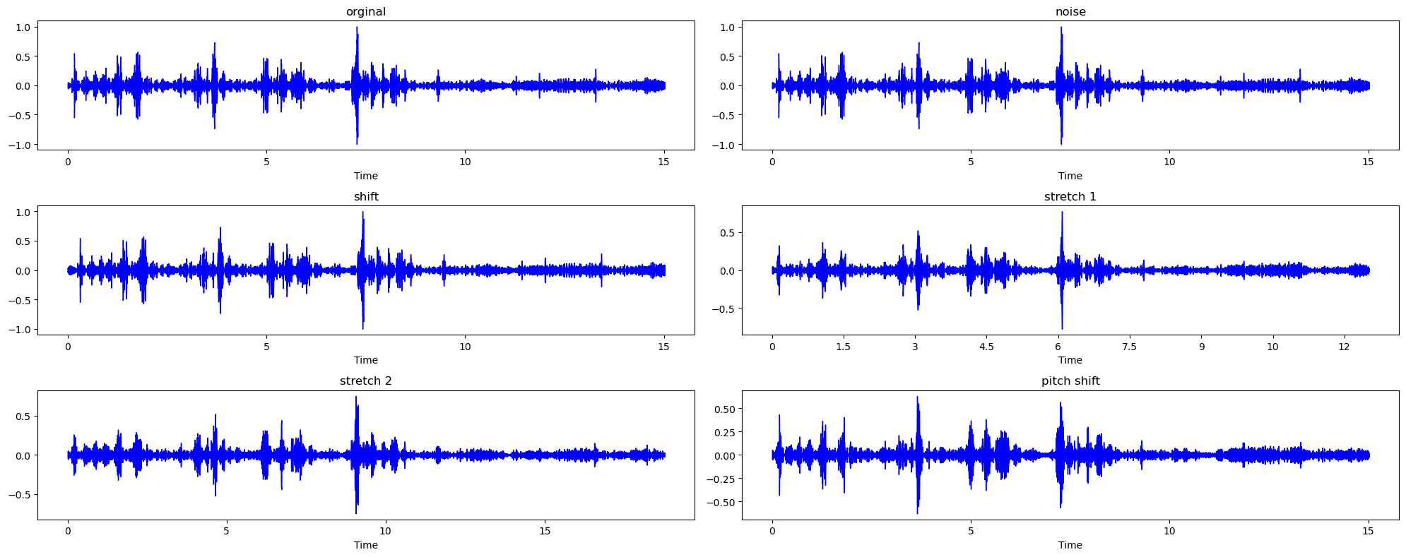
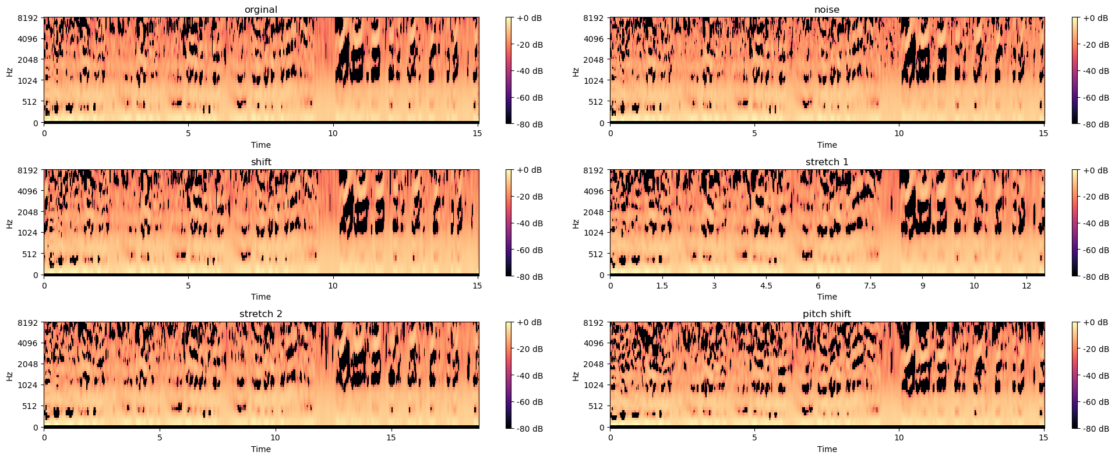
Dataset Problem
Dataset Size
Solution - Data Augmentation
Notes:
When we were implementing ML models, we faced some problems with our database. There were some classes with very few instances in our dataset. To resolve this issue, we conducted data cleaning by removing that classes to eliminate noise caused by insufficient representation. Additionally, we applied data augmentation techniques to increase the dataset size. This involved methods such as adding noise, shifting, or stretching audio files.

Slide 12
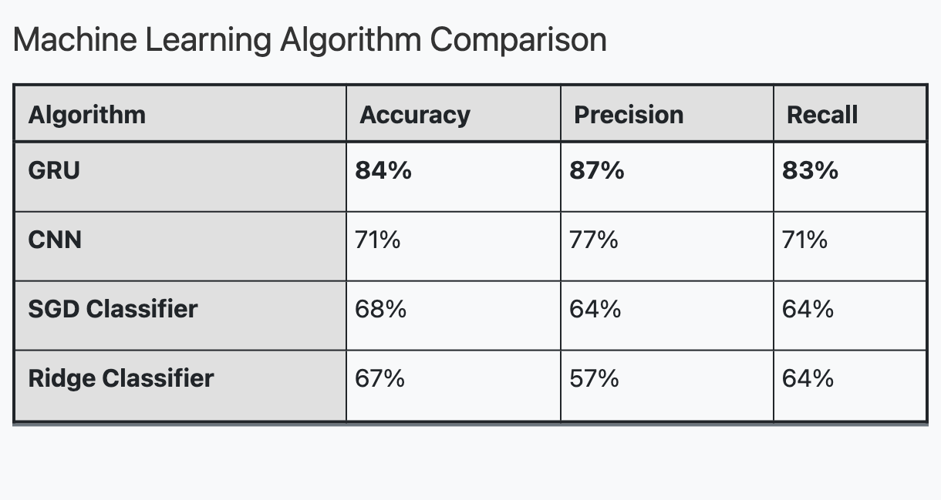
Choosing Machine Learning Model
Best ML model for Audio Classification
GRU (Gated recurrent units)
Designed for sequential data with temporal dependencies
Variable length sequences
Fewer parameters
GRU has the best performances for all three metrics
Used pandas, numpy, and tensorflow to implement GRU
Notes:
In our project, we decided to use GRU models. The first reason is that Lung sound recordings are sequential data, and GRU models are adept at capturing temporal dependencies well. Also, our data has varying lengths of 10 seconds to 90 seconds, and GRU models can handle variable-length sequences efficiently and also offer computational efficiency during training with their streamlined architecture.
GRU has the best performance for all three metrics - accuracy precision and recall. This model makes the overall predictions correctly, reduces unnecessary interventions, and identifies diseases correctly.
For implementation, we used pandas and numpy library to handle the dataset format, and tensorflow to implement GRU.

Slide 13
Challenge
Data Limitations
Initial model: Limited data ➡️ 70% accuracy.
Solution: Data augmentation ➡️ 83% accuracy.
Choosing database systems
We had many options in terms of database systems, but the question essentially came down to SQL or NoSQL.
Here are a few reasons why we chose MongoDB(NoSQL):
With our large volume of data, MongoDB’s horizontal scalability is appealing.
With Django’s ORM allows us to define data models and relationships as you would do in SQL. Along with this, through djongo, we can leverage benefits of both the ORM and MongoDB. This includes the previously mentioned manual referencing and embedded documents
MongoDB’s aggregation pipeline enables real-time data processing and complex transformations directly within the database. This was shown in calculating average respiratory cycle.
We retrieve data in bulks and mainly all together. With MongoDB’s referencing techniques, we don’t have to perform join operations each time we retrieve data.
When integrating potential other differently structured datasets, MongoDB’s dynamic schema allows us to modify our data fields with ease.
Notes:
Due to a limited dataset, our initial model achieved an accuracy of approximately 70%. However, through the implementation of data augmentation techniques, we successfully increased the accuracy to around 83%

Slide 14
Takeaway
Machine learning
Audio data processing
Model exploration
Database management
System selection factors
Integration with Django
Storing pre-trained models
Database optimization
Notes:
In this project, we've gained insights into two key areas: machine learning and database management.
Regarding machine learning, we've learned to handle audio data within this context and explored various models suitable for our dataset.
On the database management side, we've grasped the factors influencing database system selection, investigated database integration with Django, learned to store pre-trained models within our web app to infer with the user input, and lastly applied database optimization technique that were learned during lectures.

Slide 15
Possible Extensions
EHR
Collaborative features
Integrate with existing EHR systems for streamlined data exchange and interoperability.
Foster collaboration among medical professionals with integrated messaging and discussion features
Transfer learning
Mobile Accessibility
Integrate external datasets to enrich the existing database and utilize transfer learning for model adaptation
(Hoang et al., 2023)
Ensure mobile accessibility for on-the-go access to patient data and diagnostic tools
Notes:
We were able to implement all functions described in the proposal, and included more functions such as feedback system, data augmentation, and aggregation pipeline, these are the extensions that we could do more when we have more time.
Continuing our discussion, one of the extensions includes the integration of our system with existing electronic health record (EHR) systems. It will inform patient demographic data, diagnostic reports, and treatment histories, providing comprehensive patient profiles and valuable clinical insights for medical professionals.
Moreover, we can develop a mobile application and responsive web design to be fully accessible on mobile devices, allowing medical professionals to access patient data and diagnostic tools anytime, anywhere.
Additionally, we can further foster collaboration between medical professionals by integrating messaging, discussion forums, and sharing features into our platform. By doing so, experts can securely discuss patient cases, share insights, and seek expert opinions.
Furthermore, we can augment our database by integrating external datasets containing lung sound recordings and diagnostic information. It will enrich our existing database, providing a more comprehensive, accurate, and diverse dataset for analysis.

Slide 16
References
Dataset: Link
Hoang, T. V., Nguyen, Q. H., Nguyen, C. Q., Nguyen, P. X., & Nguyen, H. D. (2023,
September 4). Sound-Dr: Reliable Sound Dataset and Baseline Artificial Intelligence System for Respiratory Illnesses. PHM Society Asia-Pacific Conference. https://papers.phmsociety.org/index.php/phmap/article/view/3604

Slide 17

Thanks
Do you have any questions?

